Slide 1
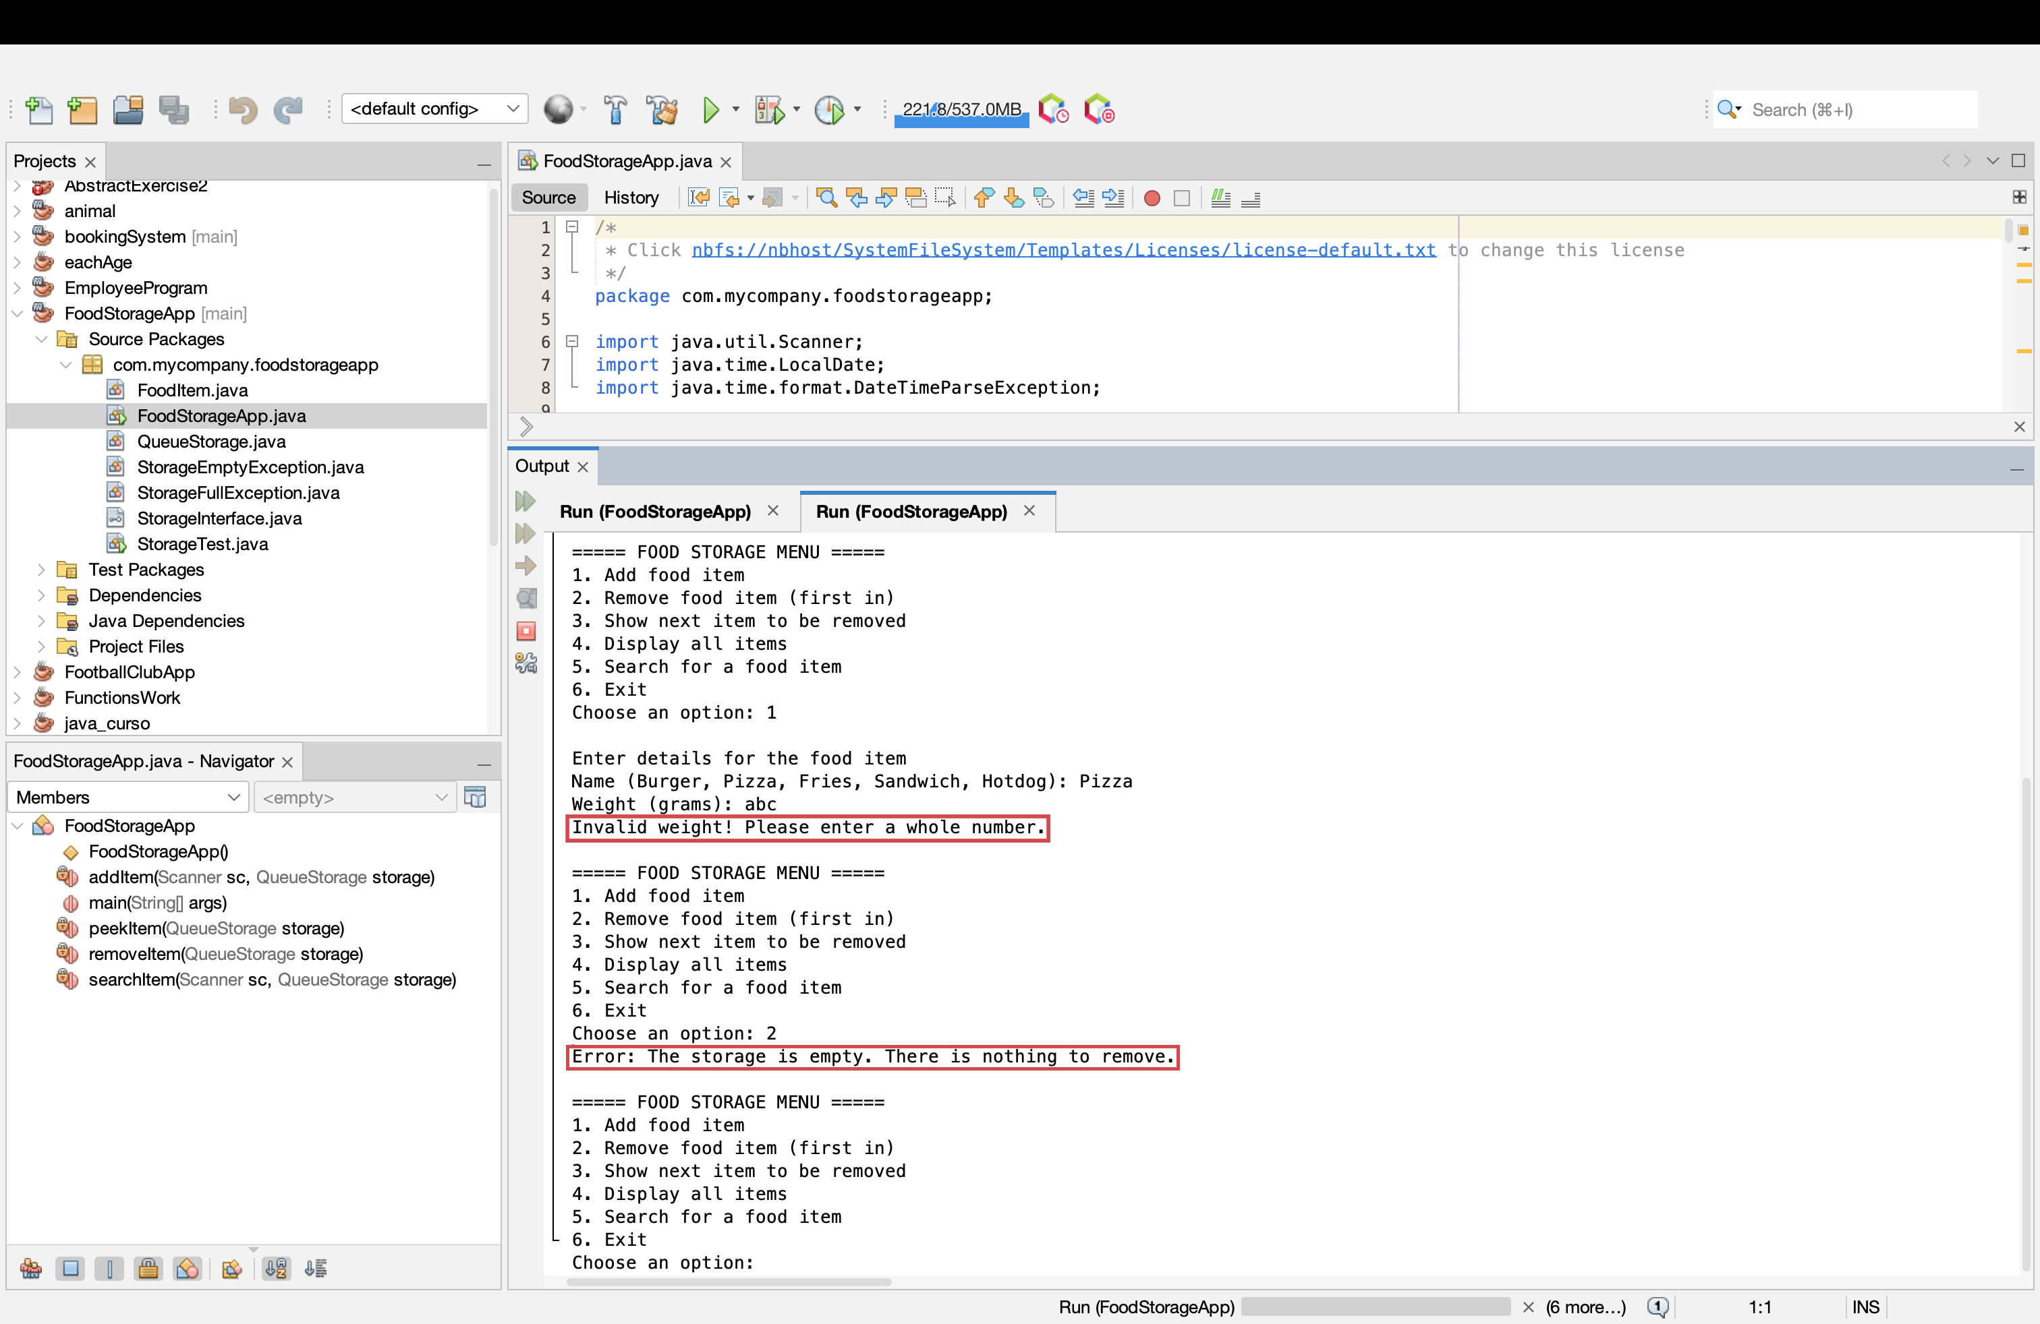





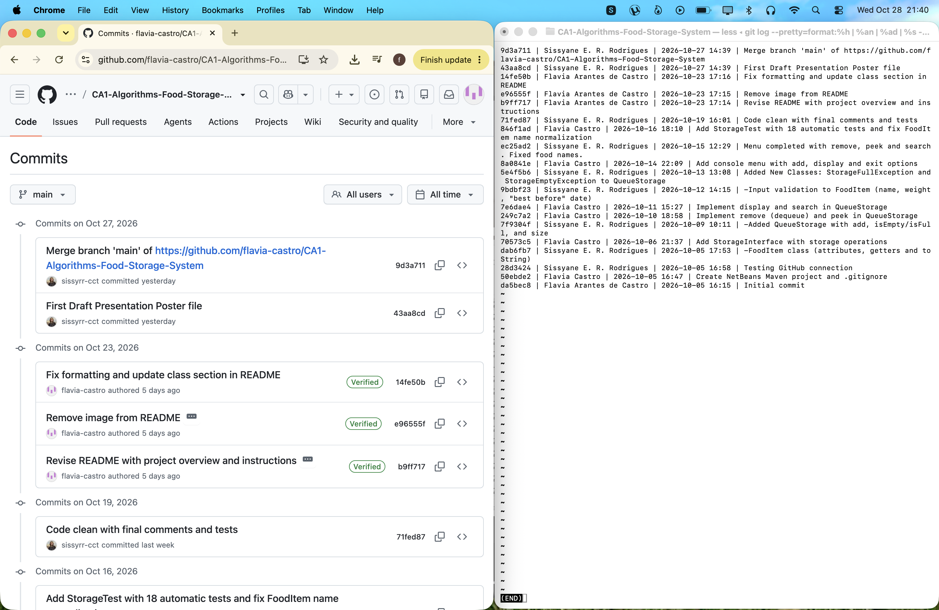
Algorithms & Constructs: Food Storage System
GitHub: github.com/flavia-castro/CA1-Algorithms-Food-Storage-System
Video Presentation: https://drive.google.com/file/d/1Ziob6ri6nQdibHtRjUXi7CGiZ11nPVpQ/view?usp=drive_link
A Java console application that stores fast-food items in a circular queue (FIFO)
Students: Flavia Castro & Sissyane Rodrigues | Lecturer: Taufique Ahmed | BSc (Hons) in Computing | CCT College Dublin
1
The Problem
4
How the Circular Queue Works
6
Class Design (UML)
8
Validation, Error Handling and Testing
A fast-food restaurant stores five types of food: Burger, Pizza, Fries, Sandwich and Hotdog. The storage unit is double-sided and will accept up to 8 trays. The chef can either add and remove food only on the same side, or alternatively on opposite sides. Each food item is given: Name, weight, best before date (maximum 14 days), and time of storage. The challenge was to choose a appropriate data structure and write a java code to simulate this scenario..
We implemented our own circular queue using an array with 8 slots for FoodItem objects. The system uses two variables: front (item to be removed first) and count (the number of items).
Enqueue: If not full, add the item at rear = (front + count) % 8 , then increase count.
Dequeue: If not empty, take items[front], clear the slot, move front = (front + 1) % 8 and decrease count.
Peek: Return items[front] without removing it.
Empty Slots: When an item is removed, its position becomes empty (null). New items use the next available rear position, and the queue wraps around to reuse earlier slots when needed.
The modulo operator (%) is used to wrap the indexes of 7 back to 0 so that the empty slots can be reused without moving the items.
« interface » StorageInterface
RuntimeException
Inputs are checked before an item is created: the name must be one of the 5 foods, the weight a whole number from 50g to 2000g, and the date in YYYY-MM-DD format, not in the past and at most 14 days ahead (Oracle, no date). Letters instead of numbers show an error, not a crash. With no data, remove and peek throw StorageEmptyException and the menu shows a clear message; a 9th item throws StorageFullException. StorageTest runs 9 tests and all pass.
MAX_CAPACITY = 8
add() remove() peek()
display() search()
isEmpty() isFull() size()
extends
ADD
implements
REMOVE
QueueStorage
throws
StorageFull
StorageEmpty
ADD
REMOVE
- items: FoodItem[8]
- front: int
- count: int
Exception
Exception
2
Proposed Solution
stores 0...8
uses
FRONT
REAR
FoodItem
FoodStorageApp
We have implemented the storing as a data structure: a Circular Queue: First In, First Out or FIFO (Goodrich, Tamassia and Goldwasser, 2014). Food is added at the back and picked up at the front, that way guaranteeing always the use of the most older tray first and also assisting in reducing food waste.. A Stack would have the newest food on top and the older food trays would be allowed to expire, whereas a standard array with shifting would have to shift food after each removal.
REMOVE
ADD
- name, weight
- bestBefore, timeAdded
+ isValidName()
+ main(): menu
empty
empty
empty
FoodItem stores the food details using private fields and getters (encapsulation). StorageInterface defines the required operations (abstraction), while QueueStorage implements them. Custom exceptions handle full and empty storage, and FoodStorageApp provides the user menu.
0
1
2
3
4
5
6
7
Figure 1: Invalid input and empty storage handled without crashing.
Data Structure | Remove | Result
Circular Queue (FIFO) | O(1), Oldest first | Chosen
Stack (LIFO) | O(1), Newest first | Oldest food may expire
Array with shifting | O(n), Shift items | Slow remove
5
Java Code: enqueue and dequeue
7
Time Complexity
9
GitHub
// enqueue - adds to the back
public void add(FoodItem item) {
if (isFull())
throw new StorageFullException(...);
int rear = (front + count) % MAX_CAPACITY;
items[rear] = item;
count++;
}
// dequeue - removes from the front
public FoodItem remove() {
if (isEmpty())
throw new StorageEmptyException(...);
FoodItem removed = items[front];
items[front] = null;
front = (front + 1) % MAX_CAPACITY;
count--;
return removed;
}
Operation | Method | Best | Worst
Add (enqueue) | add() | O(1) | O(1)
Remove (dequeue) | remove() | O(1) | O(1)
Peek | peek() | O(1) | O(1)
Display | display() | O(n)* | O(n)
Search | search() | O(1) | O(n)
Check empty/full/size | isEmpty / isFull / size | O(1) | O(1)
3
Advantages and Limitations
Advantages
Limitations
O(1) add, remove and peek
Oldest food is always removed first
Reuses empty spaces without shifting items
Simple to implement and maintain
Handles full and empty storage safely
Capacity is fixed at 8 items
Urgent items cannot skip the queue
Searching takes O(n) time
Does not prioritise expiry dates
Fixed capacity cannot expand automatically
*Display is O(1) when storage is empty; otherwise it iterates through all n stored items.
Add, remove and peek only change front or count, so they are O(1). Display prints every item: O(n). Search is linear: O(1) when the item found is at the front, the worst case is O(n). Storage space is O(n), one fixed array of 8.
Figure 2: Git log showing 19 commits by both members on different dates.
References
Programiz (2017). Circular queue data structure. [online] Programiz. Available at: https://www.programiz.com/dsa/circular-queue [Accessed 11 Oct. 2026].
docs.oracle.com. (n.d.). Lesson: Exceptions (the javaTM tutorials > essential java classes). [online] Available at: https://docs.oracle.com/javase/tutorial/essential/exceptions/ [Accessed 12 Oct. 2026].
Oracle (n.d.). Standard calendar. [online] The JavaTM Tutorials. Available at: https://docs.oracle.com/javase/tutorial/datetime/iso/date.html [Accessed 13 Oct. 2026].
Asymptotic complexity (no date) Cornell.edu. Available at: https://www.cs.cornell.edu/courses/cs3110/2014fa/lectures/24/lec24.html [Accessed: 17 Oct. 2026].

